Slide 1
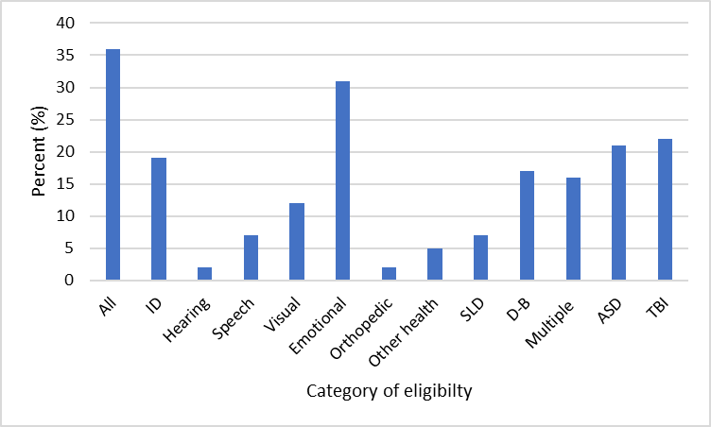
A Needs Assessment of Certified Health Teachers in Connecticut Regarding Students Receiving Special Education Services
A Needs Assessment of Certified Health Teachers in Connecticut Regarding Students Receiving Special Education Services
Tara M. Lutz, Ph.D., M.P.H., CHES®, Mary Beth Bruder, Ph.D., & Urszula Nita
The University of Connecticut A.J. Pappanikou Center for Excellence in Developmental Disabilities
People with disabilities are less likely to be involved in health promotion programs and activities and are more likely to engage in unhealthy behaviors compared to people without disabilities (CDC, 2001; CDC, 2015; WHO, 2018). According to the Individuals with Disabilities Education Act (IDEA, 2004), all students, including children with disabilities, have a right to education. Children with disabilities can receive special education services if determined eligible according to criteria set forth in the IDEA or Section 504 of the Rehabilitation Act of 1973. In order to teach health education in a public school in Connecticut, teachers are required to have one of the following: a PK-12 health education teaching certificate endorsement (043) or school nurse/teacher certificate endorsement (072) (CGS, 1993).
The purpose of this needs assessment is to describe how students who receive special education services are included in health classes and what strategies and adaptations, if any, are used to make the curriculum accessible.
Methods
All CT certified health teachers for the 2018-2019 school year, according to Connecticut State Department of Education Educator Data System, were invited to participate in this needs assessment via email. The final sample (n=64) was majority female (73.4%), had been teaching more than 10 years (79.4%), and had been teaching in their current district for more than 10 years (67.7%).
Results
Almost 92% reported that all students including students who receive special education services are included in health class.
About 80% of respondents indicated that decisions regarding inclusion are made based on IEP/504 plans, followed by teacher recommendation (32.8%) and family opt-in (25.0%). One reported, “Some students that are identified as Tier 3 interventions are pulled out of health or other specials until they meet academic goals.”
Questions pertaining to specific strategies utilized in classrooms were adapted from the Center for Disease Control and Prevention’s School Health Policies and Practices Study (SHPPS). The most commonly reported strategies were using modified assessments (92.2%) and providing preferential seating (90.6%) [Table 1].
Table 1.
While more than half of teachers reported having received both academic training and in-service professional development to adapt general curriculum, fewer reported having received training specific to health education curriculum adaptation [Table 2].
Table 2.
Specific strategy utilized for students receiving special education services | Percent (%)
Assigning a teacher or aide to assist students | 81.3
Assigning note takers or readers for class work | 31.3
Coordinating assignments with special education teacher | 71.9
Increasing skill modeling, practicing, or repetition | 54.7
Providing preferential seating | 90.6
Simplifying instruction content or varying the amount of difficulty of material taught | 78.1
Using modified assessments | 92.2
Using modified instructional strategies | 68.8
 | General curriculum (%) | Health education curriculum (%)
Received academic training to adapt curriculum | 65.6 | 17.1
Received in-service professional development to adapt curriculum | 52.4 | 36.4
Conclusions and Next Steps
Results will help provide a more complete picture of health education for students who receive special education services. Findings will add to the growing body of literature about providing education, including health education, to all students who receive special education services, evidence on best practices to provide health education to these students. Furthermore, results will identify areas to improve pre-service and in-service training and professional development opportunities specific to adapting health education curriculum.
References
Centers for Disease Control and Prevention. (2001). Healthy People 2010, objectives report: Chapter 6: Disability and secondary conditions. Atlanta, GA. Retrieved from https://www.cdc.gov/nchs/data/hpdata2010/hp2010_final_review_focus_area_06.pdf
Centers for Disease Control and Prevention. (2015). CDC Promoting the Health of People with Disabilities. http://www.cdc.gov/ncbddd/disabilityandhealth/pdf/aboutdhprogram508.pdf
Conn. Gen. Stat. SS 166-10-145d. (1993). Retrieved from
https://www.cga.ct.gov/2015/pub/chap_166.htm#sec_10-145d
Individuals with Disabilities Education Act, 20 U.S.C. § 1400 (2004).
Section 504 of the Rehabilitation Act of 1973, 29 U.S.C. § 794 et seq.
World Health Organization. (2018). Disability and Health. Retrieved from http://www.who.int/news-room/fact-sheets/detail/disability-and-health
Teachers also most frequently reported that it is equally challenging to adapt health education curriculum to include students who receive special education across all eligibility categories [Figure 1].
Figure 1.
Acknowledgements: The research reported in this paper was supported, in part, by funding from the U.S. Department of Community Living (ACL), Administration on Intellectual and Developmental Disabilities (AIDD) (Award #90DD0015). The opinions expressed, however, are those of the authors and do not necessarily reflect the official position of the Department or Office.

